Slide 1
Reading Data From a 10 DOF IMU
Dominique Anguiano
Email: anguian3@unlv.Nevada.edu

Slide 2
AIM & ACCOMPLISHMENT
AIM:
To Read values from the 10 DOF IMU and Save them onto a cloud based server via the use of Wi-Fi.
ACCOMPLISHMENT
Read data from every sensor
Accelerometer
Barometer
Compass
Gyroscope
Uploaded all the data into their own tables on the ThingSpeak website.

Slide 3
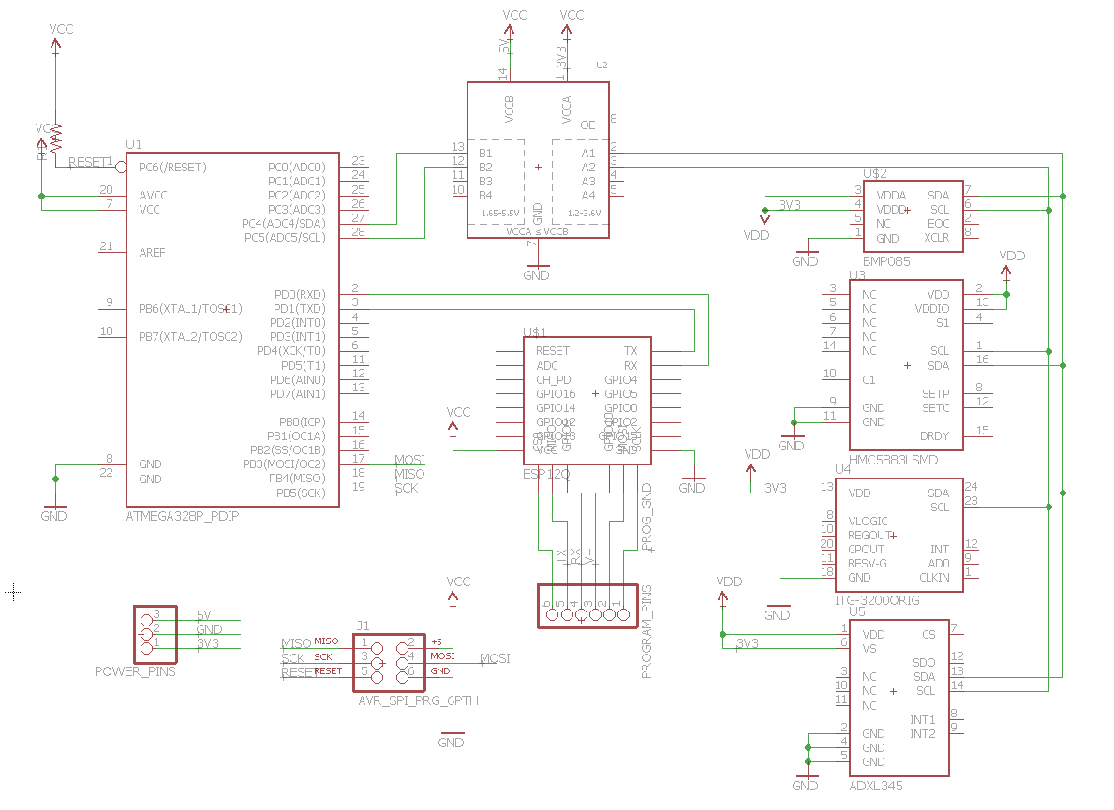
SCHEMATIC

Slide 4
DESIGN STAGES
Components
AVR ATMEGA328p
10 DOF Mems IMU Sensor from DFRobot
Adafruit Huzzah ESP8266 Breakout
4-channel I2C-safe Bi-directional Level Shifter
Interfaces
Atmega328p – IMU using I2C
Barometer – Address (0x77)
Accelerometer – Address (0x1D)
Gyroscope – Address (0x68)
Compass – Address (0x1E)
Atmega328p – Huzzah ESP8266 using UART
OIT
ThingSpeak

Slide 5
CODE DEVELOPMENT
Initialization
Initialize ESP8266 to receive data via UART
Initialize each sensor of the 10DOF IMU
Data Collection
Collect data from one sensor at a time
Send the data all at once to ESP8266
Visualization
Graphs on ThingSpeak showing how values are changing over time

Slide 6
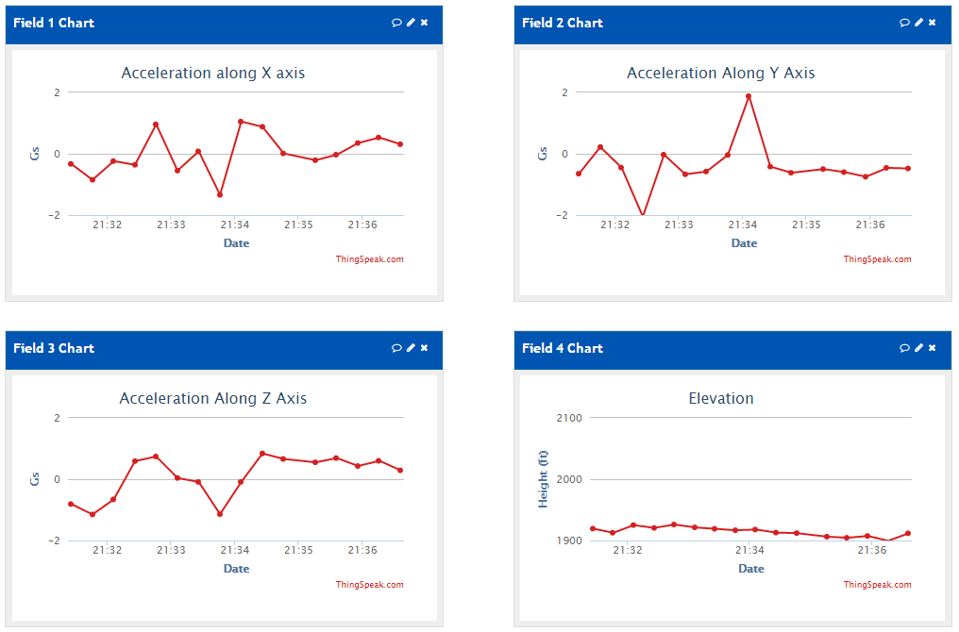
Demo Snapshots

Slide 7
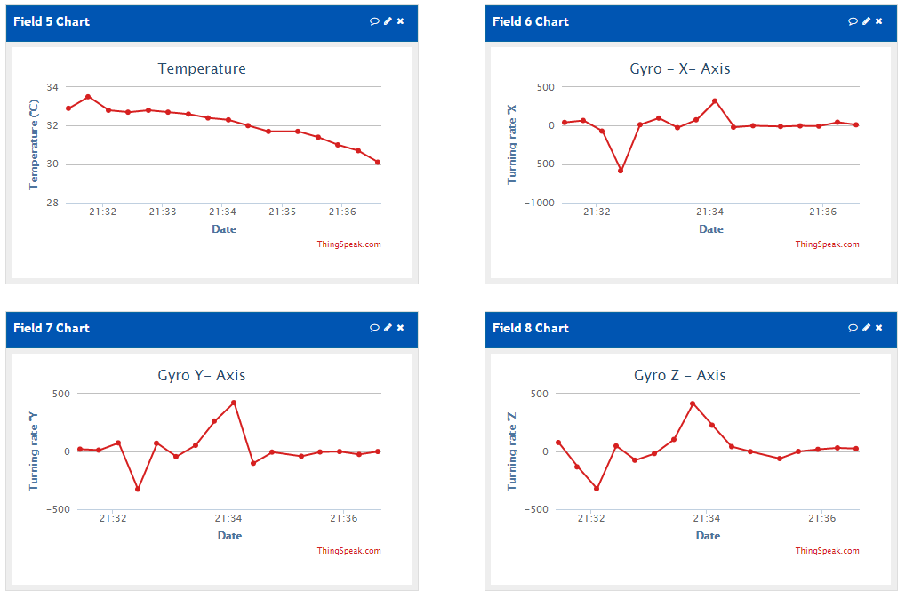
Demo Snapshots

Slide 8
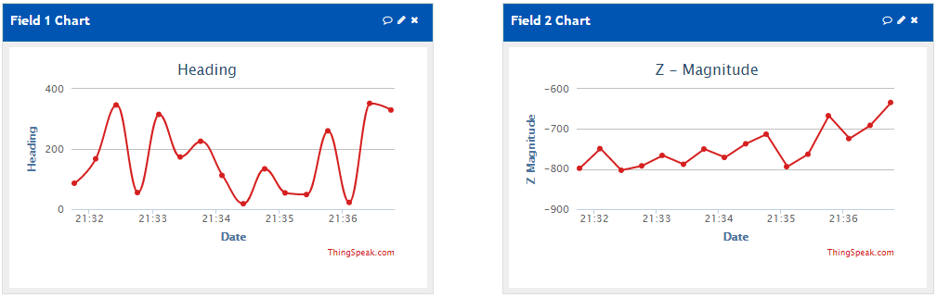
Demo Snapshots

Slide 9

DEMO VIDEO
Video Link: https://www.youtube.com/watch?v=KVI4KMxK6Yw

